Slide 1
Cambridge
IGCSE
Computer Science
Paper 1
Speakers, screens and projectors
Unit 3: Input and output devices

Slide 2
Objectives:
Describe the principles of operation of the following output devices:
Loudspeakers
Screens and monitors
Multi-media light projectors

Slide 3
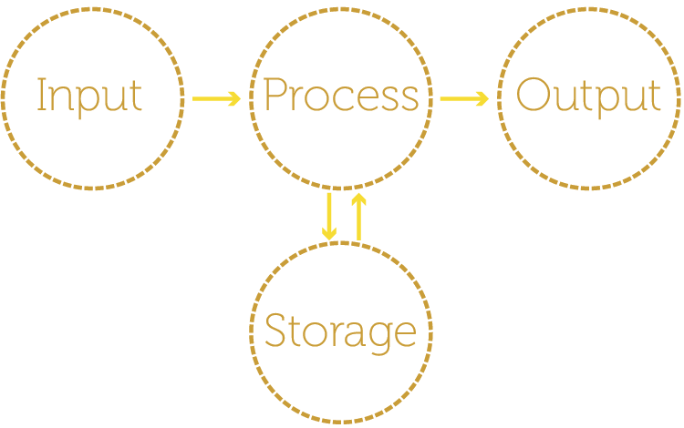
Output devices in the model

Slide 4
Output devices
Output devices take data produced by a computer and turn it into a human-readable form (such as an image on a screen)
Output from a computer is sometimes used to operate another device (e.g. a loudspeaker)
The most common output devices are: printers, screens, loudspeakers and multimedia projectors

Slide 5

Loudspeakers and headphones
Digital data is sent from the computer to a Digital to Analogue Converter (DAC) where it is converted into an analogue signal
The signal is then boosted using an amplifier and finally sent to a speaker

Slide 6
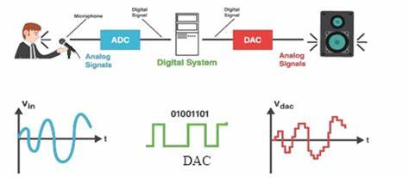
Loudspeakers and headphones
Digital data is sent from the computer to a Digital to Analogue Converter (DAC) where it is converted into an analogue signal
The signal is then boosted using an amplifier and finally sent to a speaker

Slide 7

Screens / Monitors
CCFL - Cold Cathode Fluorescent Lamp
LCD - Liquid Crystal Display
LED - Light Emitting Diode
OLED - Organic Light Emitting Diodes

Slide 8
LCD Screens / Monitors
Liquid Crystal Display (LCD) screens are made from millions of pixels
Each pixel is effectively a separate red, blue or green diode / light that can be switched on or off electronically using liquid crystals to rotate polarised light
The pixels are switched on or off very quickly to make the moving colour picture
Because LCDs do not emit any light, some type of back-light technology needs to be used.

Slide 9
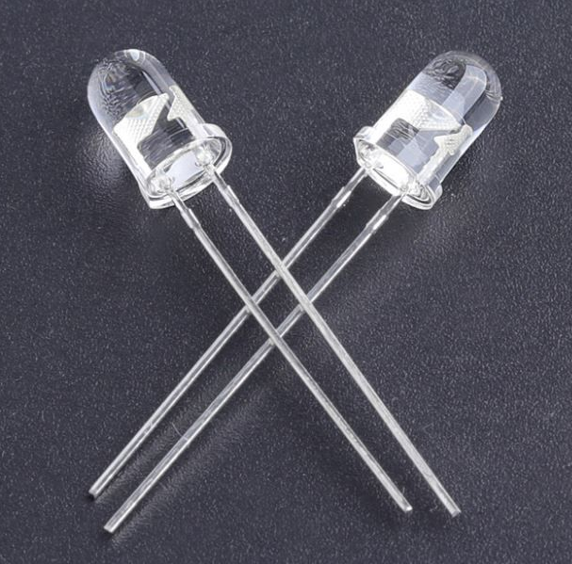
LED screens
An LED screen is actually an LCD screen, but…
instead of having a CCFL backlight, it uses LEDs (light emitting diodes) as a source of light behind the screen
CCFL - cold cathode fluorescent lamp
LEDs - light emitting diodes

Slide 10
Advantages of LEDs over LCDs
Using LEDs to back-light LCD screens has a number of advantages over the older CCFL technology:
They reach their maximum brightness almost immediately (no need to warm up)
They produce a brighter light which leads to better colour definition and sharper image
Since LEDs are very small, screens can be much thinner
They last almost indefinitely, which makes the screens much more reliable
They consume very little power and therefore produce very little heat a -> reduced running costs

Slide 11
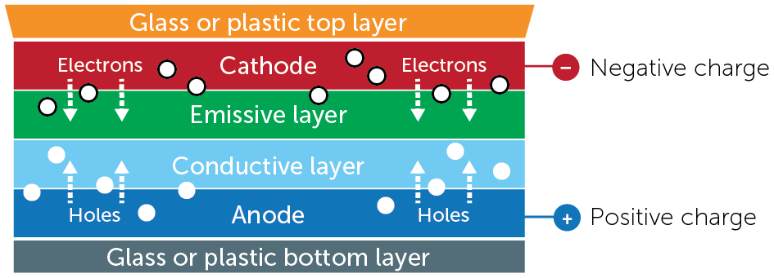
Organic LED technology
Organic LED (OLED) technology uses organic materials (carbon compounds) to create semi-conductors which are flexible.
Electrons flow from the cathode towards the positive anode
‘Holes’ represent a space for a missing electron
When the ‘holes’ meet electrons they cancel each other out and emit energy in the form of light
A set of red, green and blue OLEDs works like an LCD pixel

Slide 12
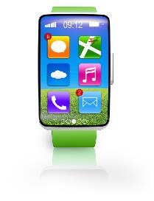
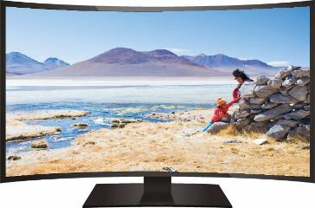
OLED screens
OLED screens are much thinner and lighter than normal LCD or LED screens
They use organic materials (carbon compounds) to create semi-conductors which are flexible.
Plastic, rather than glass also makes them flexible
The light emitted from an OLED system is much brighter than the LCD or LED screens

Slide 13
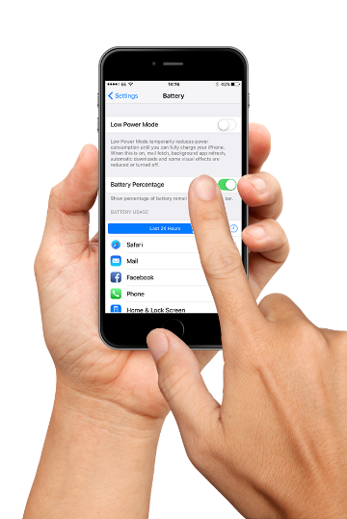
OLED screens
Other benefits:
OLEDs generate their own light so there is no need for extra back lighting -> very thin screens
Much less power is needed, which is important for battery operated devices like mobile phones, tablets and smart watches. Also means little heat is produced and running costs are reduced.
They have a larger field of view than LCD screens, especially when the screen is curved.

Slide 14
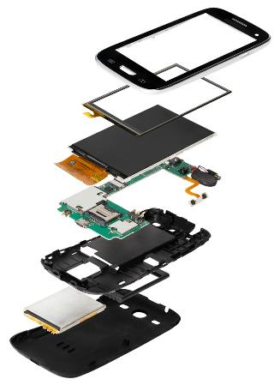
Drawbacks of OLED technology
OLED is a new technology with drawbacks that are likely to decrease with development over time
Increased production costs
OLED layers wear out about four times faster than LCD or LED screens
OLED screens are affected by water and other contaminants

Slide 15
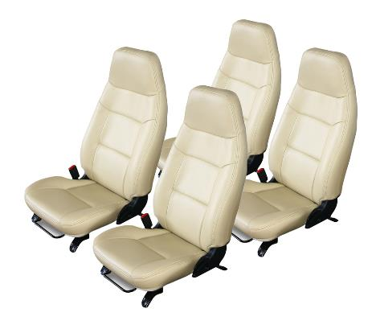
Worksheet 5
Now complete Task 1 and Task 2 on Worksheet 5

Slide 16
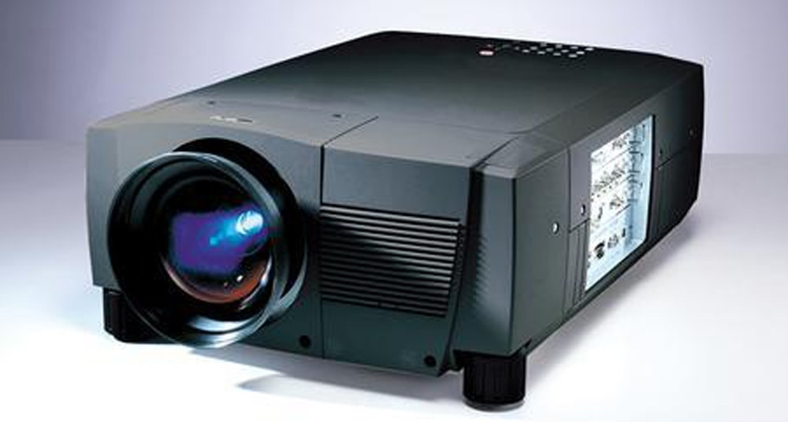
Multi-media light projectors
Projectors are used to show computer output onto large screens and interactive whiteboards.
They are often used in presentations.
There are two common forms of light projectors:
Digital Light Projectors (DLP)
Liquid Crystal Display (LCD) light projectors

Slide 17
Digital Light Projectors (DLP)
DLP systems utilise millions of micro-mirrors on a small microchip within the projector (each mirror corresponds to a single pixel)
When these micro-mirrors are tilted towards the light source, they are in the ‘on’ status
If they are tilted away from the light source, they are in the ‘off’ status
The micro-mirrors can switch between ‘on’ and ‘off’ thousands of times a second creating different and changing shades of grey light

Slide 18
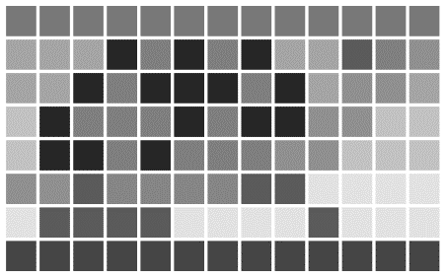
Using grey light
DLP projectors use a grid of mirrors that can each produce over a thousand shades of grey
If a micro-mirror is in the ‘on’ status more than it is in the ‘off’ status, then it produces a lighter shade of grey – if it’s the other way round, then a darker shade of grey is produced
This creates a greyscale video image using grey ‘mirror’ pixels

Slide 19

Adding colour with DLP
A strong white light passes through colour filters on a rapidly spinning wheel which converts it into red, green or blue light
A filtered green light shone onto a tilted ‘off’ mirror reflecting dark grey light, projects a dark green pixel
A purple pixel is created by rapidly changing a pixel from blue to red which our brain interprets as blend of the two colours

Slide 20
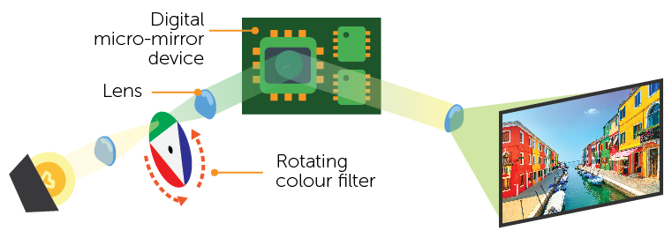
Digital Light Projectors (DLP)
How a DLP projector works

Slide 21
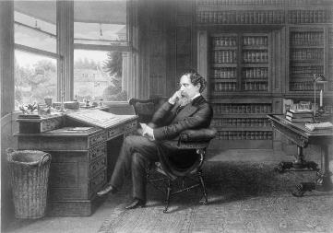
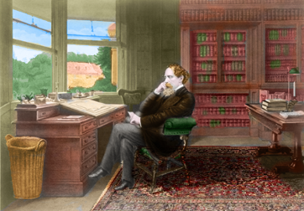
Grey scale to colours
Using a graphics package, a grayscale image can be colorized in a similar way to a Digital Light Projector
This black and white image of Charles Dickens is likely to have been taken before colour photographs were invented in 1861
A colorized version might look like this:

Slide 22
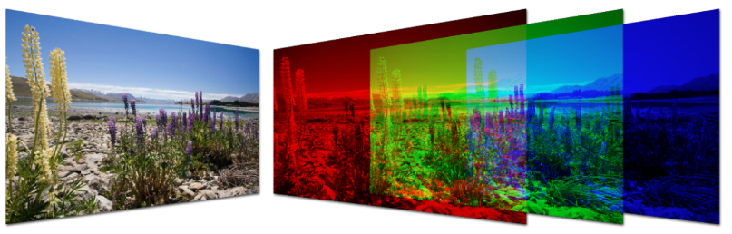
LCD projectors
Like DLP, LCD projectors depend on a very bright source of white light
The white light is sent to Dichroic mirrors and the light is reflected back with red, green or blue wave lengths
The three coloured light components pass through three LCD screens containing the image from the computer to be projected

Slide 23
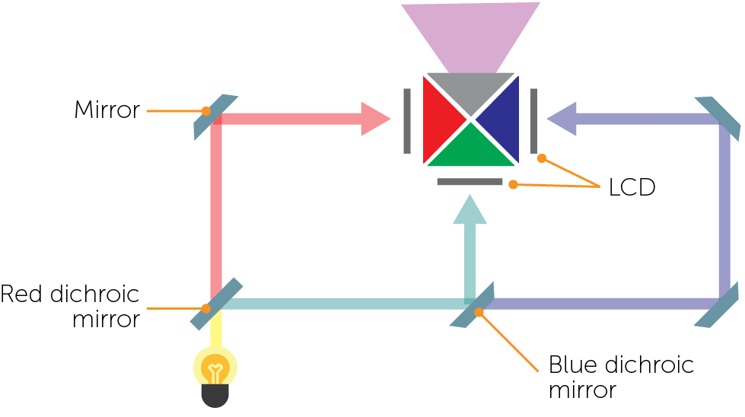
LCD projectors
The three images are then combined using a prism to produce the full colour image which then passes through a lens and is projected on to a screen

Slide 24
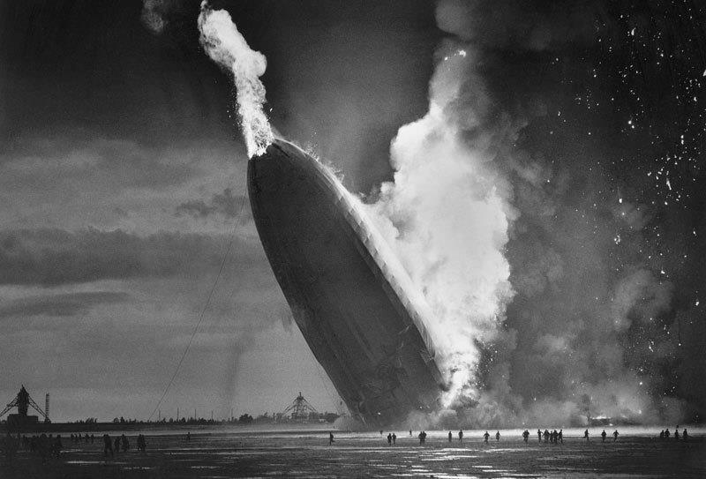
Worksheet 5
Now complete Task 3 on Worksheet 5

